Slide 1
Opportunity for Criminals?
COVID-19 Pandemic
Yinhe Lu and Yuki Nishimura

Slide 2

Introduction
Criminals have been taking advantage of vulnerabilities due to COVID-19.
How are COVID-19 and crimes related?
We focus on burglary and robbery.
(Source: Twitter)
Our analysis is based on data from the following sources:
NYCHealth (COVID-19 Cases in NYC from March 2nd to April 12th 2020)
SpotCrime (Burglary and Robbery cases in NYC from March 2nd to April 12th for years 2018 to 2020)

Slide 3
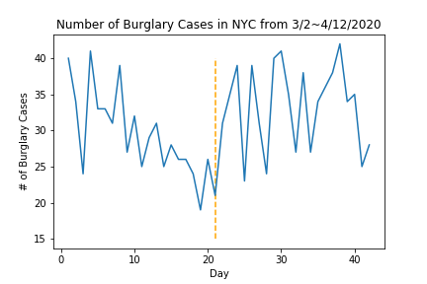
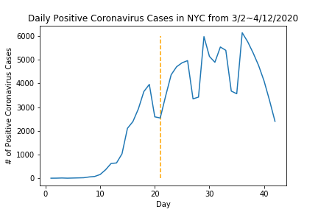
Burglary vs Coronavirus
Obvious difference before and after the shelter-in-place order
Hypothesis
Before the order, burglars were not able to find a good target due to uncertainty in location of people
After the order, with people at home and closed businesses, businesses became an easy target
Shelter-in-place order
Correlation
vs COVID-19 Cases before order | vs COVID-19 Cases after order | vs COVID-19 Cases throughout
-0.62 | 0.58 | 0.20
(First two correlations are statistically significant at significance level 0.01)

Slide 4
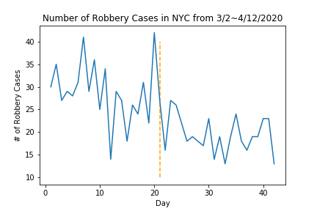
Robbery vs Coronavirus
Obvious difference before and after the shelter-in-place order
Hypothesis
Before the order, robberies occurred regardless of uncertainty in where people were due to nature of crime
After the order, robbers did not need to use force to commit robbery since they can target empty businesses
Correlation
vs COVID-19 Cases before order | vs COVID-19 Cases after order | vs COVID-19 Cases throughout
-0.33 | -0.13 | -0.62
(Last correlation is statistically significant at significance level 0.01)

Slide 5
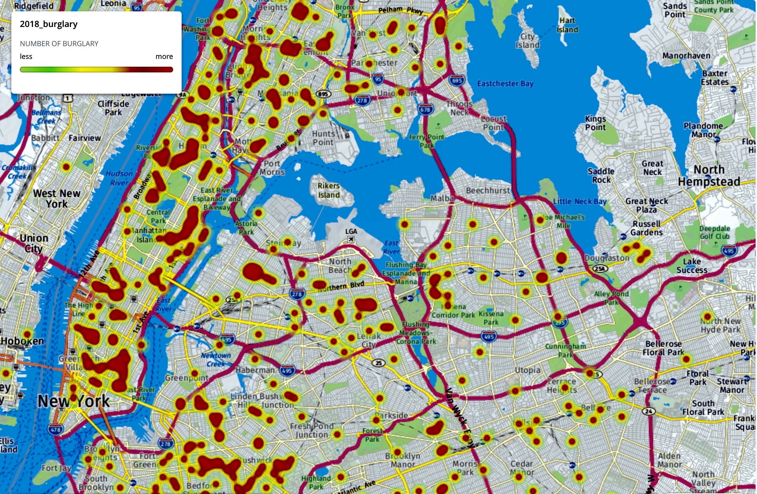
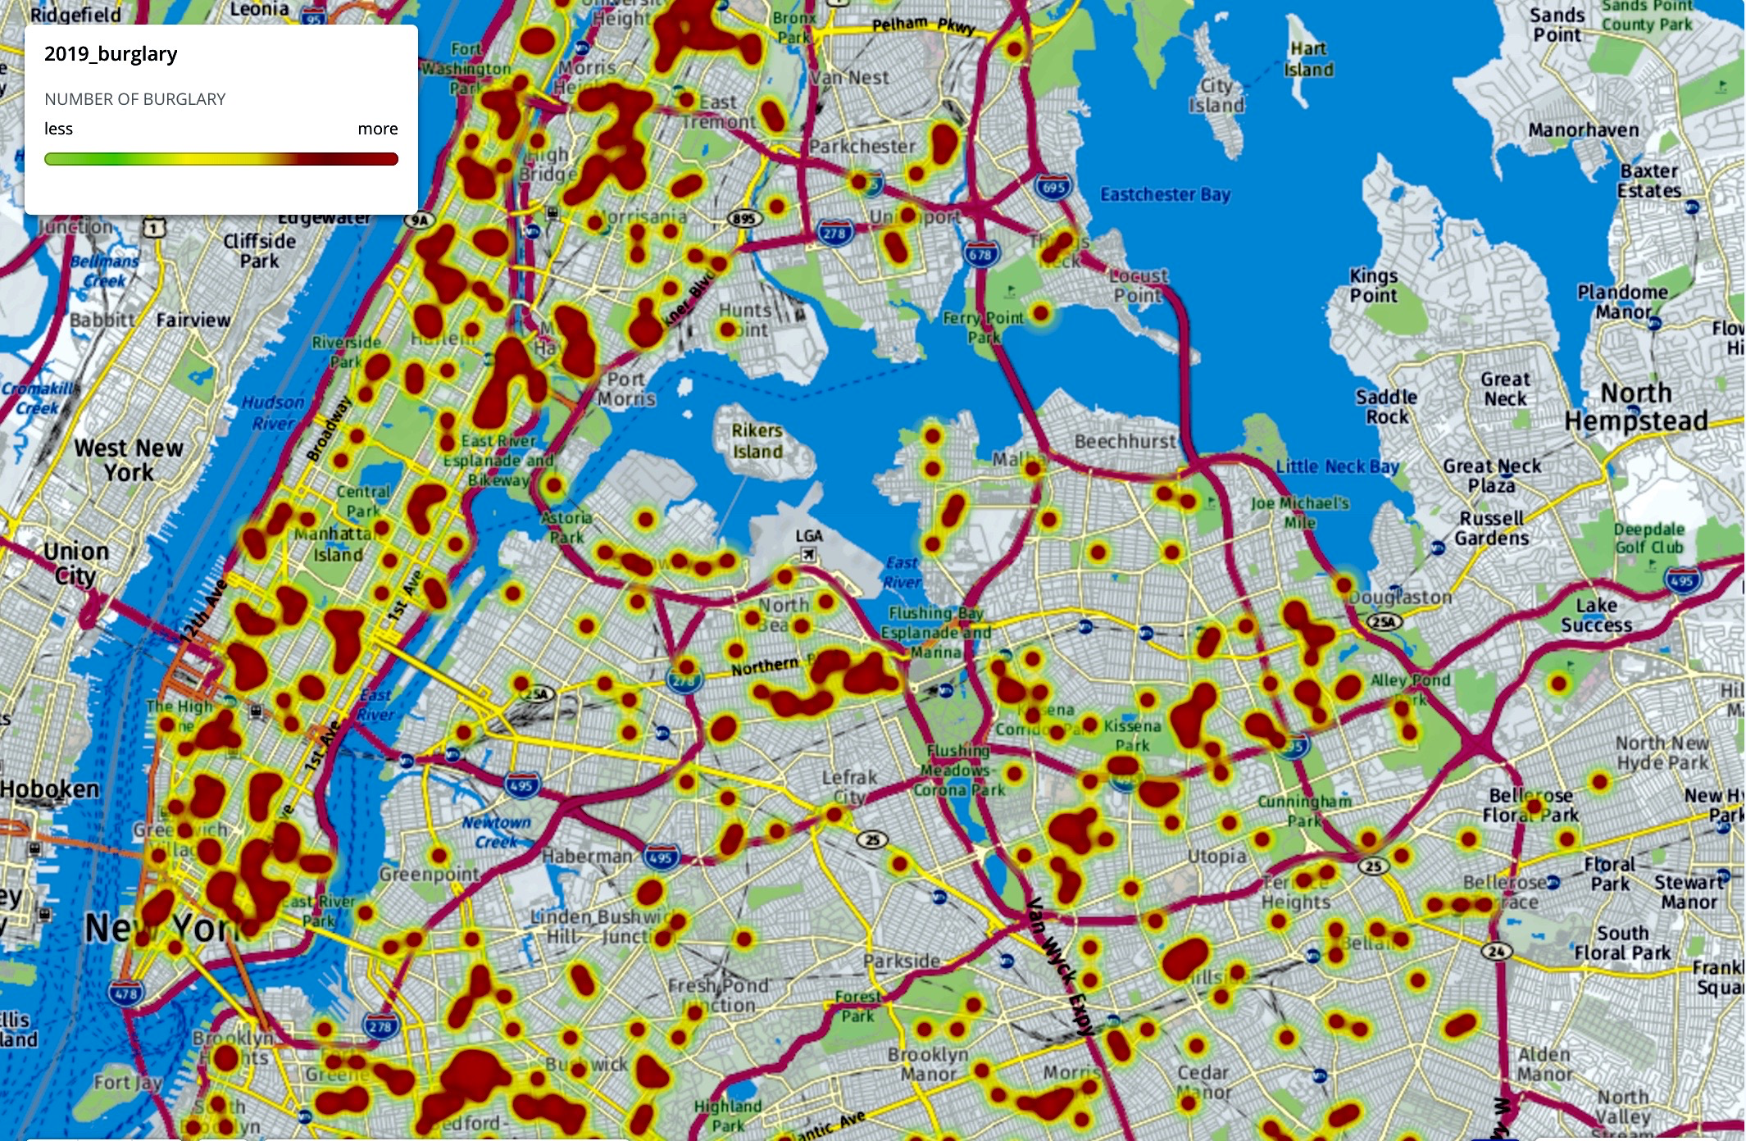
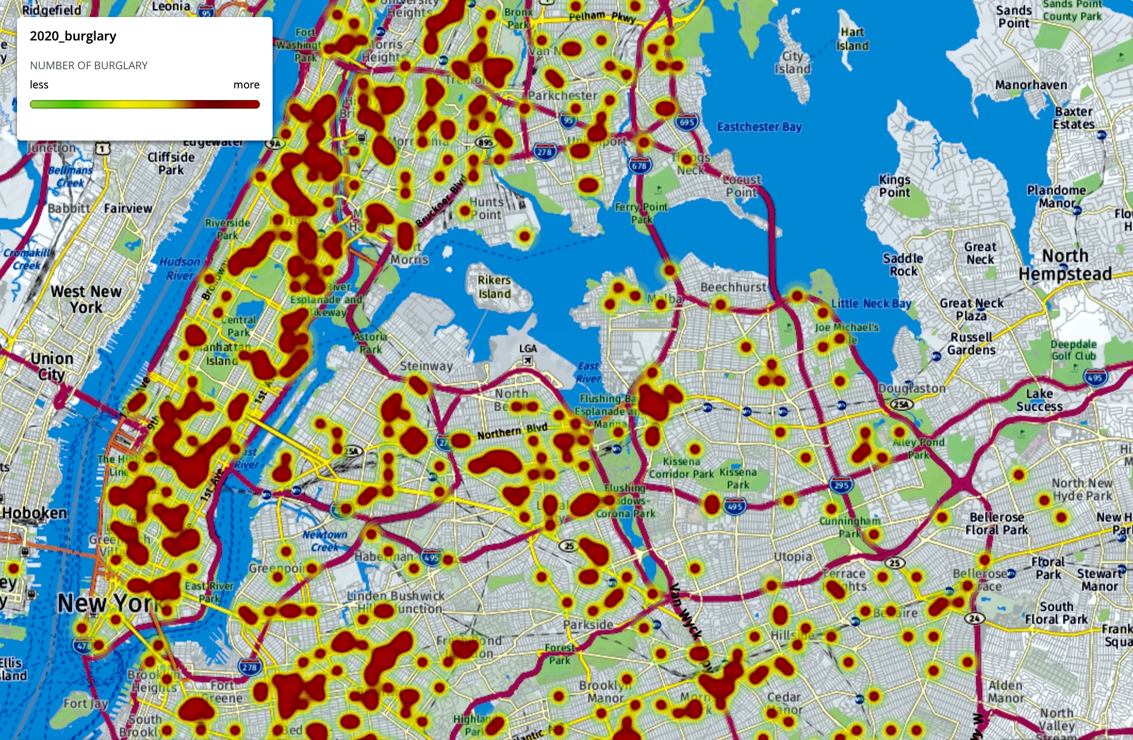
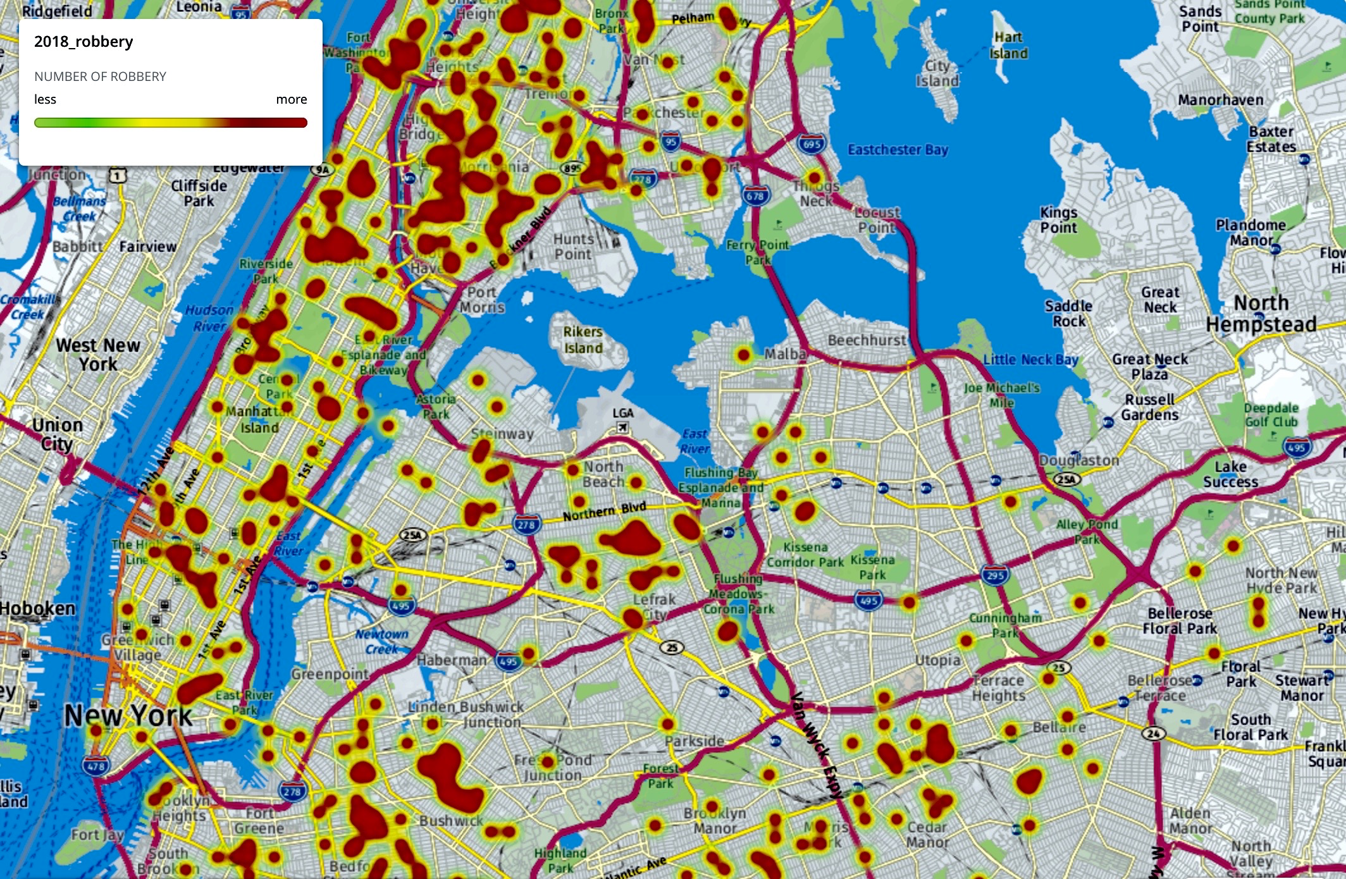
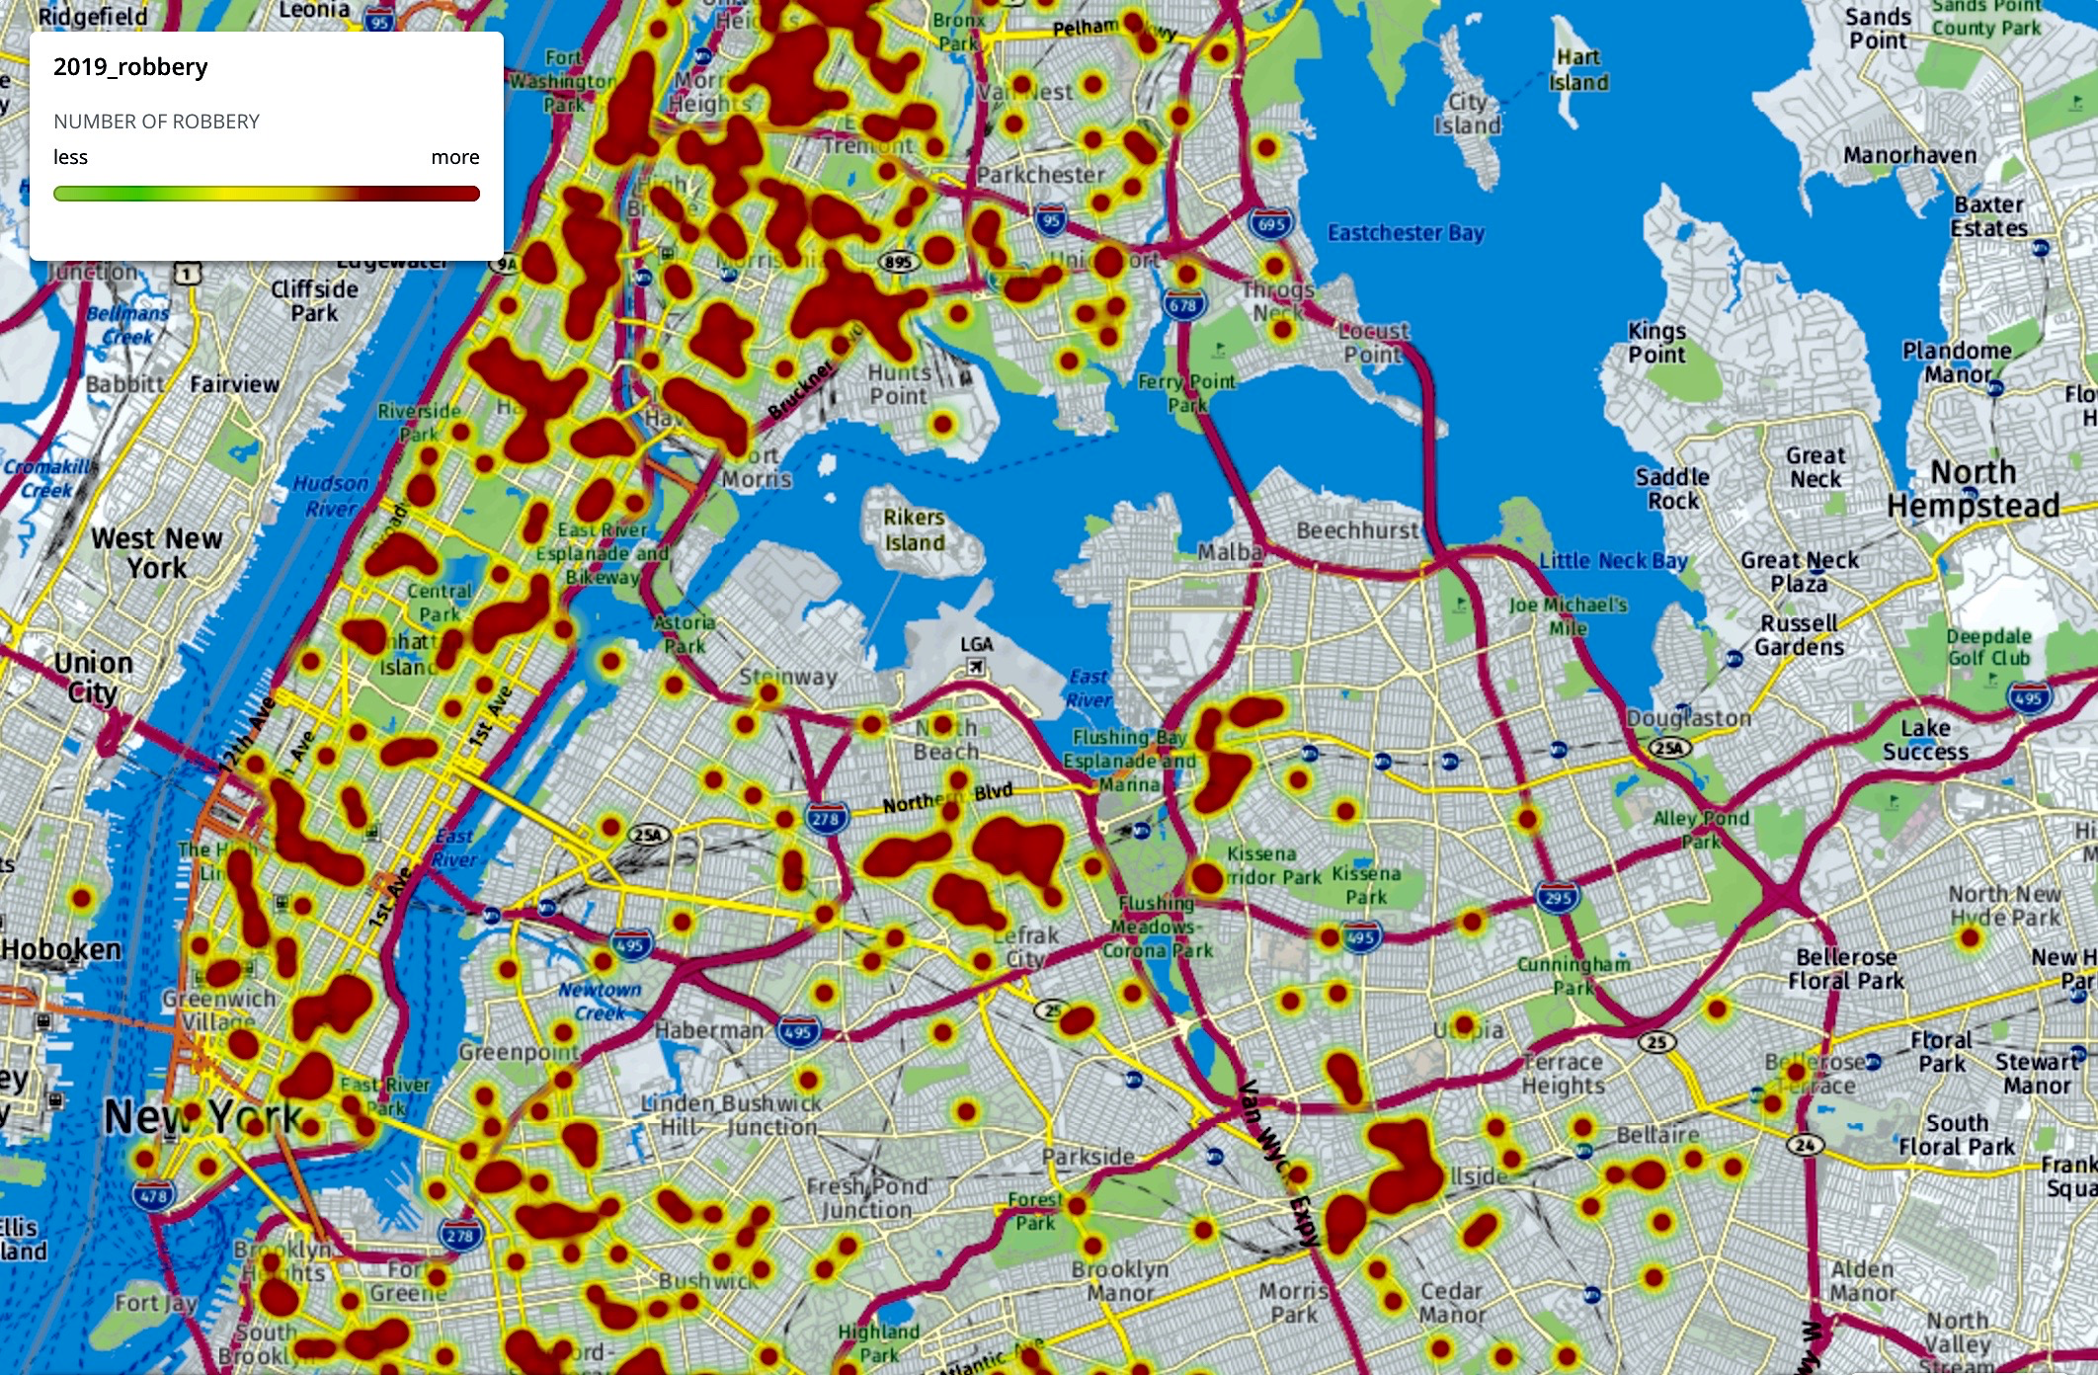
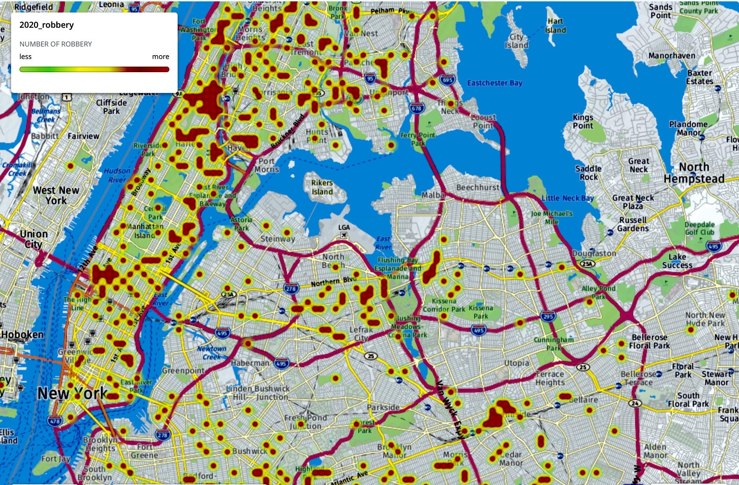
Crime Heatmaps
2018
2019
2020
Burglary
Robbery
(Heatmap uses data from March 2nd to April 12th for all years)

Slide 6
Summary
Shelter-in-place order makes burglaries easier and criminals are shifting strategies during pandemic.
Empty properties near Midtown Manhattan can be vulnerable to burglaries.
The pandemic may be an opportunity for criminals, but it is also an opportunity for us to serve good for the society.
Stay safe and well!
(Slide Template was borrowed from PoweredTemplate.com)

